Slide 1

Once again about Mariana and the future
environment mandatory Insurance
Gloria Faria

Slide 2

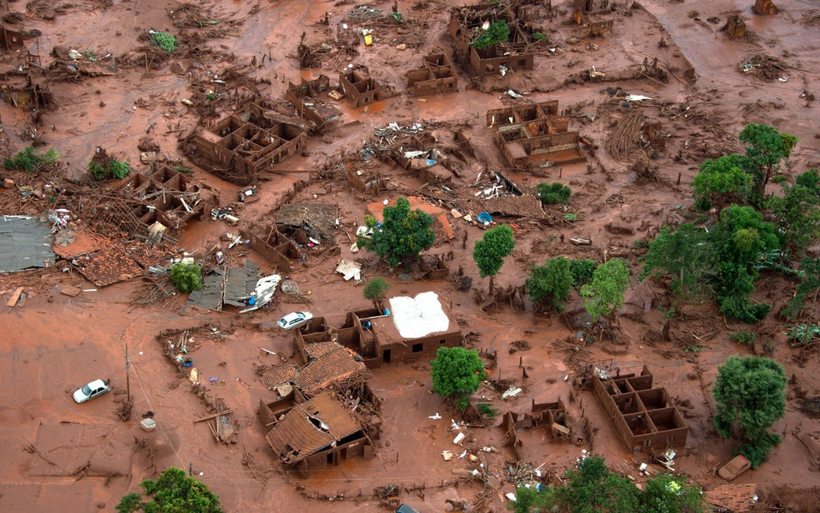
On 5 November, the biggest environmental disaster in the History of Brazil took place. The Fundão Dam failed leaving behind a trail of mud from the district of Bento Rodrigues, in Mariana, Center area of Minas Gerais, as far as to the ocean.

Slide 3
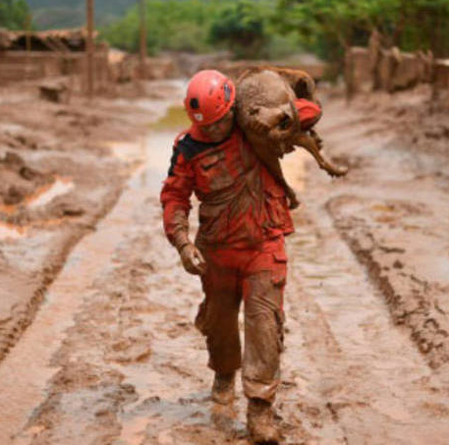
The iron waste arrived at the Rio Doce affecting more than 40 cities, devastating the land through its path in Espírito Santo and changing the lives of thousands of people.
To date the number of fatal direct and indirect victims from this tragedy has not been closed. The collapse affected the economy of the entire region causing damages of all kinds.

Slide 4

Ações Judiciais
Criminal Lawsuit
On 18 november, 2016, Samarco, its controllers and 22 people became defendants in a criminal lawsuit investigating 19 deaths classified as homicides.
Environmental Lawsuit
The environmental lawsuit filed due to this tragedy is valued in R$ 155 billion.
The Public Civil Action filed by the Union, by the governments of Minas Gerais and of Espirito Santo and by Federal environmental agencies ordered a deposit in the amount of R$ 1,2 billion for the recovery of damages caused.
Such amount corresponds to the first installment of the total amount of R$ 20 billion.
Minas Gerais Court of Justice has already accepted about 50 thousand individual lawsuits motivated by the contamination of the Rio Doce waters.

Slide 5
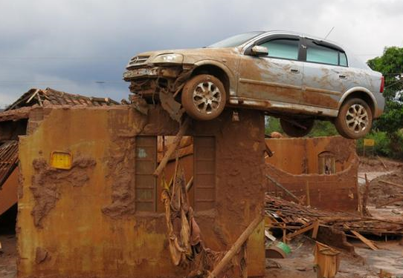
Ações Judiciais
Civil Lawsuits
The collapse of the dam made Samarco the target of thousands of civil lawsuits, such as, for example, compensation to school teachers of that area, compensation for cars buried in the mud, compensation to fishermen from the area, indemnification for the losses of their houses and etc.
Labor Agreements
Samarco committed not to collectively layoff until 31 March, 2017. Simultaneously it was compelled to adopt several legal labor mechanisms such as paid leave of absence, collective vacations and layoffs.

Slide 6
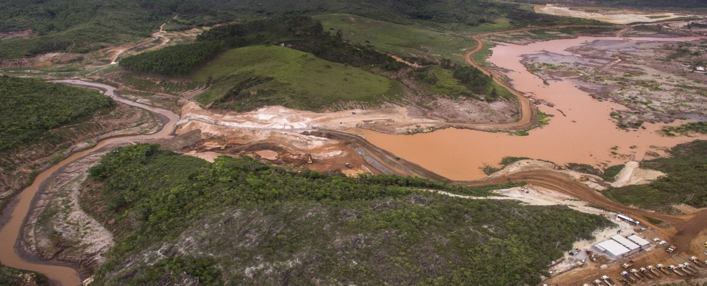
Ações Judiciais
International Lawsuit
The Anglo-Australian mining company BHP Billiton published this Monday (23) that it had been notified in a collective lawsuit filed in Australia, for the noncompliance of its obligation to inform its investors.
The lawsuit claims for losses suffered by the company’s shareholders between October 2013 and November 2015 as the result from the drop in BHP’s shares value. Approximately 3.000 investors joined forces to file a collective lawsuit. In this period, BHP’s shares dropped 22% in Sydney’s Stock Market and 23% in London and Johannesburg.

Slide 7

Bill #767 / 2015
“Amendment of Law #6.938, of 31 agosto, 1981 (Brazilian Environment Policy), to allow the claim for Environmental Insurance whenever it becomes necessary to have an Environmental Impact Study (EIS) and a Environmental Impact Report (EIR) approved by the Senate and forwarded to the House of Representatives for Revision.”
Presented to the Senate immediately after Mariana’s environmental disaster, the Bill creates a compulsory environmental insurance as a pre-condition for the granting of an environmental license for the initiation of operation of enterprises or activities using environmental resources.

Slide 8
BILL #10.794 / 2018
Author: Senate – Senator Vaudir Raupp - MDB/RO
Status: approved by the Senate and forwarded to the House of Representatives; it is awaiting for a Rapporteur to be appointed by the Committee of Constitution, Justice and Citizenship (CCJC)
Origin: PLS 767/2015
,

Slide 9
Bill #10.794 / 2018
Article 1st - Article 10 of Law #6.938 of 31 August, 1981 (Brazilian Environment Policy), is now in force added by the following §§ 5th and 6th:
“Art. 10. ............................................................................................. ...........
§ 5th Without any harm to all other requirements applicable to environmental licensing, the licensing environmental agency shall be consulted whenever it is necessary the preparation of an Environmental Impact Study (EIS) and an Environmental Impact Report (EIR) as set forth in insert XIII of Article 9 of this Law, about the need to present evidence on the hiring of environmental insurance as a condition for the granting of an Environmental License for the starting of the operation of an enterprise or activities that use environmental resources, effectively or potentially pollutant or capable, in any way or form, of causing any environmental degradation.
§ 6º The amount insured in the environmental insurance shall be set during the licensing initial phase by the licensing environmental agency, following objective criteria established in the Regulation. (NR)
Art. 2º This Law becomes valid and in full force on the date of its publication. Senate, 26 June, 2018.”

